Slide 1
Project Name:
LIBRARY MANAGEMENT SYSTEM.
Course Name:
Programming in Java.
Subject Code:
CSE2006.
Submitted By:
Prince Raj(24BAI10700)
Submitted To:
VIT BHOPAL University.
Date of Submission:
28-03-2026

Slide 2
INTRODUCTION:
This report details the design, implementation, and testing of the Library Management System. This project mainly uses the concept of Object-Oriented Programming, specifically Multilevel Inheritance, to model a real-world library environment. The system provides a functional simulation of standard library operations, offering a modular, efficient, and user-friendly experience.
Problem Statement:
Traditional library systems often require efficient software solutions to manage large volumes of books and users. The core problem addressed in this project is the design and implementation of a simplified, console-based library management system that automates essential operations. The system should manage book records, handle issue and return operations, and maintain data accuracy while ensuring ease of use.

Slide 3
Functional Requirements:
Book Management Module:
This system allows the user to add new books by entering details such as Book ID, Title, Author,
Genre, and Availability Status.
Input: User data via console.
Output: A new Book object is created and stored in memory.
Issue and Return Module:
This system allows users to issue and return books. A book can only be issued if it is available.
Input: Book ID and user action.
Output: Updated availability status or an error message.
Information Display Module:
This system displays all book details, including availability status and issued records.
Input: User menu selection.
Output: Formatted book information.

Slide 4
Non-Functional Requirements:
Usability:
The system provides an intuitive, numbered console menu for easy navigation.
Reliability:
The system handles invalid inputs (e.g., wrong Book ID, invalid options) without crashing and displays
appropriate error messages.
Performance:
Operations such as issuing and returning books execute efficiently and provide real-time feedback.
Maintainability:
The code is modular due to multilevel inheritance, with proper comments and meaningful variable names.
System Architecture:
The system follows a Layered Architecture implemented using Multilevel Inheritance.
Presentation Layer: Handles user interaction through a menu-driven interface.
Business Logic Layer: Contains logic for issuing, returning, and managing books.
Data Layer: Stores book details and their current status.

Slide 5
Design Diagrams:
https://drive.google.com/file/d/19Npp3blndgQLnTY0BpkRXw-ihxp9q4Xm/view?usp=sharing
Design Decisions & Rationale:
Multilevel Inheritance: Chosen to model a natural "is-a" relationship. A Library System is-a Library Operations which in turn is-a Book. This promotes code reusability and logical structuring of the system.
Encapsulation: All instance variables are declared as protected to allow access to subclasses
while restricting access from unrelated external classes.
Scanner Object: Placed in the base class Book so that all derived classes can inherit and use
the same Scanner object for input, avoiding resource duplication.
Implementation Details:
The system is implemented in a single .java file for simplicity, but the classes are logically
separated. Key implementation aspects include:
The Library System constructor initializes book details and manages system setup, demonstrating structured initialization.
Input validation in issue() and return Book() methods ensures data integrity and prevents invalid
operations.
The library Menu() method uses a do-while loop to provide a continuous user experience.

Slide 6
Testing Approach:
A manual black-box testing approach was used.
Test Case 1 (Add Book): Verified correct storage and display of book details.
Test Case 2 (Issue Book): Issued a book successfully when available.
Test Case 3 (Issue Unavailable Book): System displayed "Book not available!".
Test Case 4 (Return Book): Book status updated correctly after return.
Challenges Faced:
Challenge 1: Managing user input errors.
Solution: Implemented input validation and error handling.
Challenge 2: Designing class hierarchy.
Solution: Separated responsibilities into different classes logically.
Learnings & Key Takeaways:
Understood practical implementation of multilevel inheritance.
Improved knowledge of Java OOP concepts.
Learned handling of user input and system validation.

Slide 7
Future Enhancements:
Implement a collection (like an ArrayList) to manage multiple books and users efficiently instead of handling
limited records.
Add a password-based authentication system for secure access to the library system.
Replace the console interface with a Graphical User Interface (GUI) using Swing or JavaFX.
Integrate with a database (e.g., MySQL) for persistent storage of book and user data.
Implement a book reservation system and fine calculation for overdue returns.
References:
Oracle Java
Documentation: https://docs.oracle.com/javase/8/docs/technotes/guides/language/index.html
GeeksforGeeks - Multilevel Inheritance in Java.

Slide 8
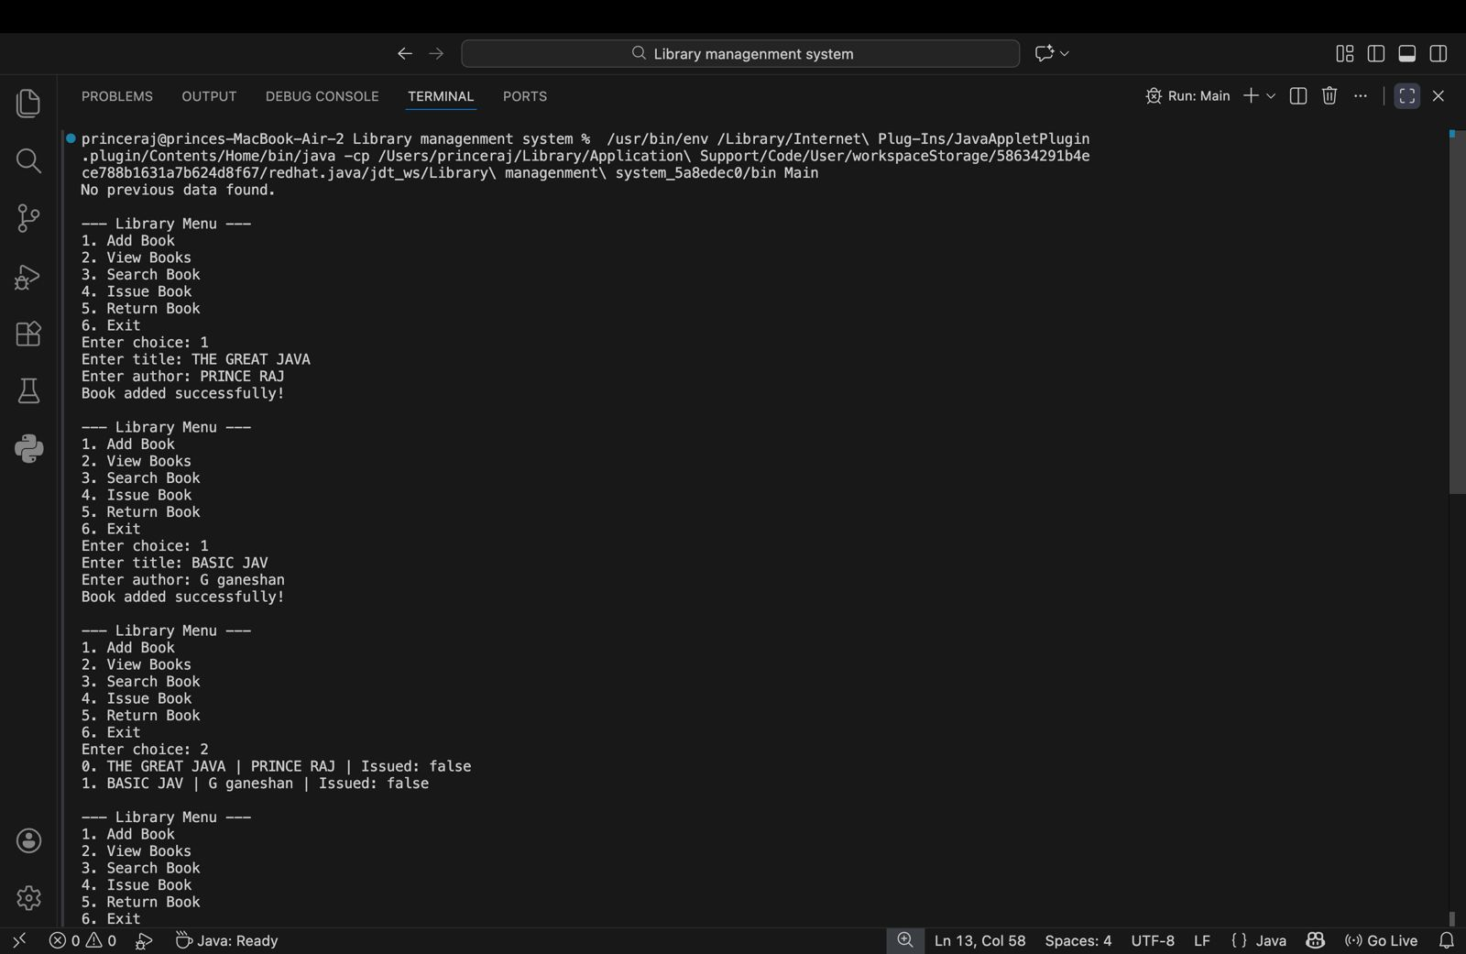
Results Screenshots :

Slide 9
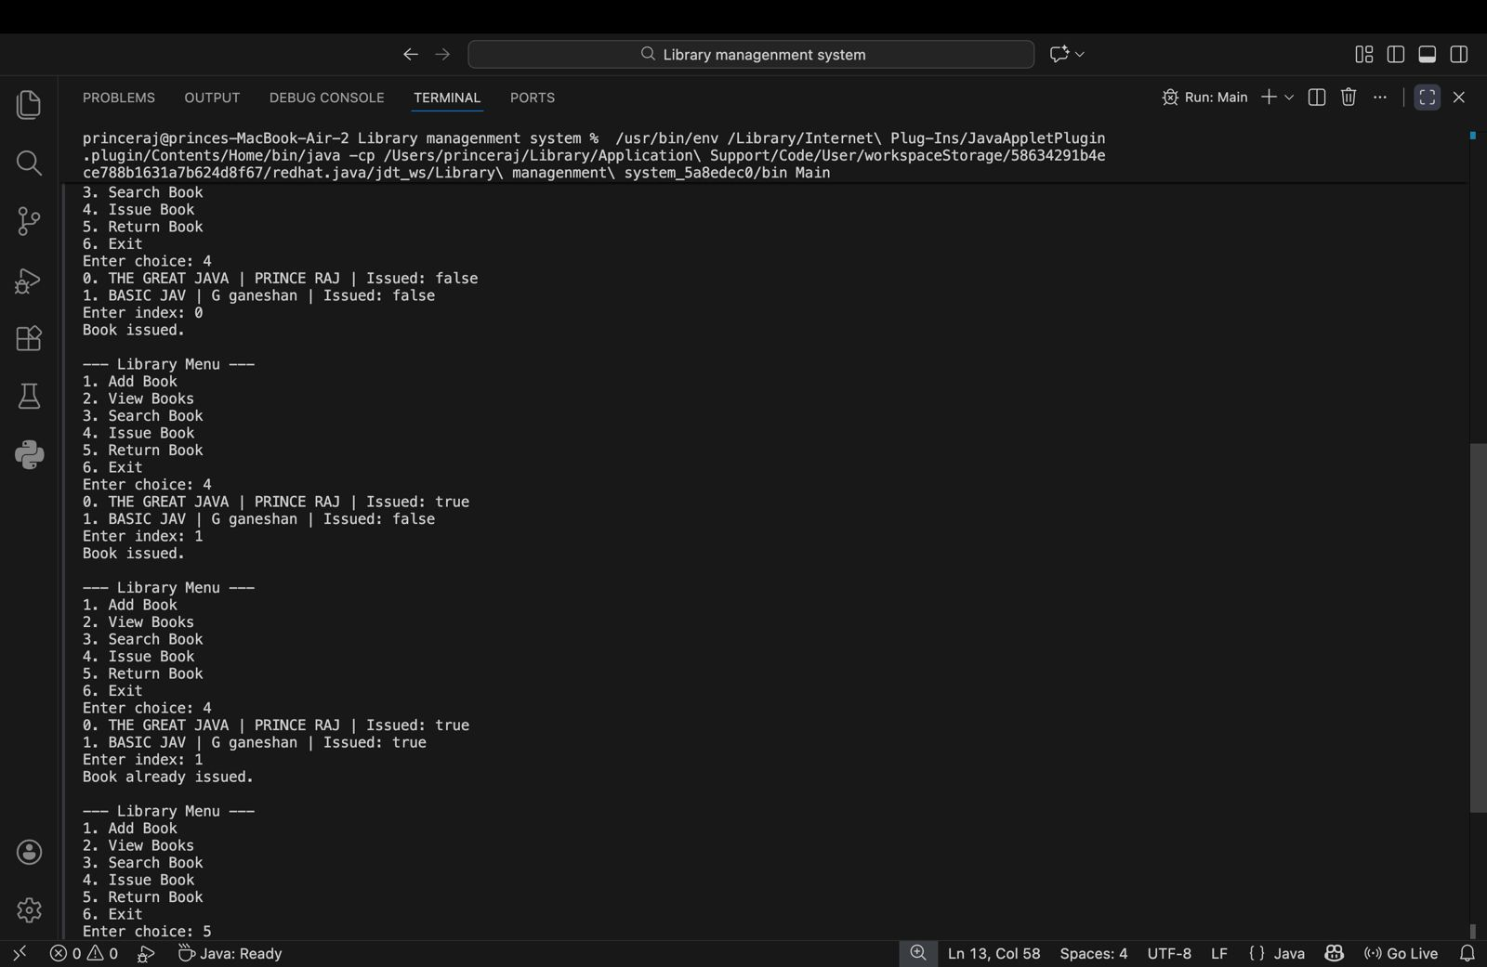

Slide 10
